Slide 1
Call us
(+63)452806078
Website:
www.showamop.com

Slide 2
Call us
(+63)452806078
Website:
www.showamop.com
SOPI new product
“ORGANIC PURE BLACK” 100% raw material from sugarcane by product. Which maybe use as:
energy fuel,
fertilizer,
partial cement replacement material,
raw material for ceramic
and many more.
This product is intended for customers who are looking basically for only raw material that they can be use for making their own product too.

Slide 3
100%NATURAL
ORGANIC COCO BROWN!
Website:
www.showamop.com
Call us
(+63)452806078

Slide 4
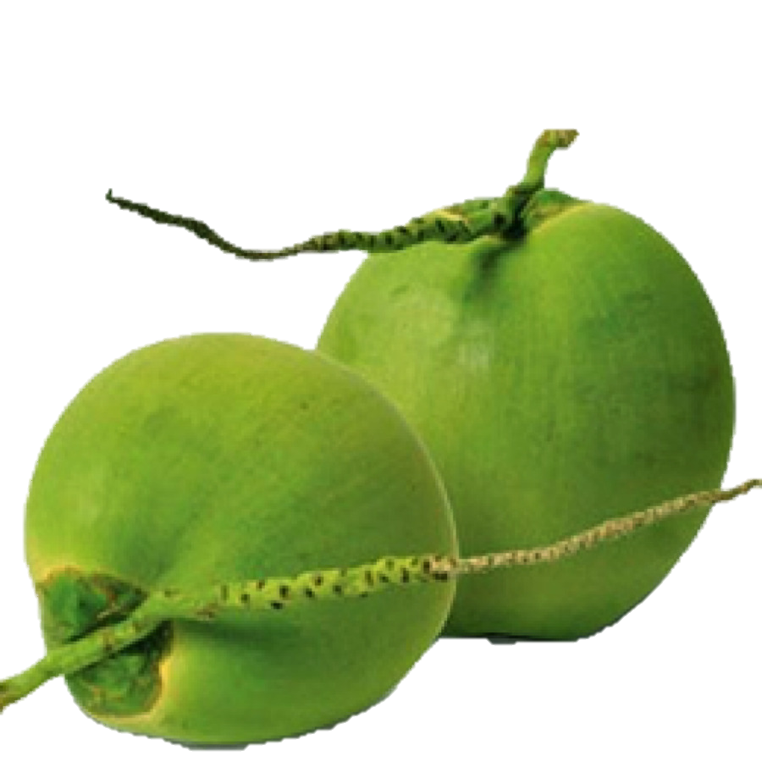
Tired of using fertilizers that aren’t giving you the best out of it? Expensive but not worthy? It says natural but the content shows opposite? How’s that?
Well, you’re probably wondering why I am telling you this? Because we’ve developed a solution to your problem. Were not going to offer you the promising one, of course, there is no such thing like that, but we can definitely prove to you that its very Inexpensive and worthy plus the benefits you are getting in using our product.
Here it is! We introduce to you Our
ORGANIC COCO BROWN!
CONTACT US!
100% raw organic material
Eco-friendly
Perfect for all kinds of gardening
Boost the oxygen supply to the roots
Free from weeds, pests, diseases
Website:
www.showamop.com
Call us
(+63)452806078
Made from 100% raw organic material with high water holding capacity. Provides an Antifungal benefits to soil giving your plants a natural pesticide. It provides a great environment for beneficial fungi and bacteria to grow. There is an action of aeration which can give a better root growth results in growing better plants. Aeration can give a Better root growth results in better plant growth. It can be a growing medium like as soil substitute.
Get yours now!

Slide 5
Call us
(+63)452806078
Made from 100% raw organic material with high water holding capacity. Provides an Antifungal benefits to soil giving your plants a natural pesticide. It provides a great environment for beneficial fungi and bacteria to grow. There is an action of aeration which can give a better root growth results in growing better plants. Aeration can give a Better root growth results in better plant growth. It can be a growing medium like as soil substitute.
Get yours now!
Website:
www.showamop.com
100% raw organic material
Eco-friendly
Perfect for all kinds of gardening
Boost the oxygen supply to the roots
Free from weeds, pests, diseases
Tired of using fertilizers that aren’t giving you the best out of it? Expensive but not worthy? It says natural but the content shows opposite? How’s that?
Well, you’re probably wondering why I am telling you this? Because we’ve developed a solution to your problem. Were not going to offer you the promising one, of course, there is no such thing like that, but we can definitely prove to you that its very Inexpensive and worthy plus the benefits you are getting in using our product.
Here it is! We introduce to you Our
ORGANIC COCO BROWN!

